Slide 1
E-Farm
Agriculture Management System

Slide 2
Synopsis

Slide 3
Objective of the project:
The name ‘E-Farm' indicates Intelligent Agriculture.
‘E-Farm ' is a model farmer management website application.
This site helps the farmers to sell their agricultural produce online and suggests best -in-practice farming processes.
Hence, providing a wider market and helping them to not restrict themselves to the local market.
It features online shopping for fertilizers, pesticides, machinery & tools, etc.
As a whole, ‘E-Farm’ provides a concept of virtual agricultural trade to its users.

Slide 4
Modules of the project
Customer account module
Product module
Category module
Location module
Production module
Purchase request module
Purchase order module
Seller module
Labourer module
Work request module
Article and blog module
Dashboard Module

Slide 5
Project Category:
RDBMS (Relational Database Management System)
Language(s) to be used:
Design and Interface: HTML ,CSS
Programming language: PHP
Scripting language: AJAX, Javascript
Database: MySQL Server

Slide 6
Software Requirements Specification

Slide 7
Purpose
This Document includes software requirements for the “E-Farm” Project. The purpose of this document is to detail the user requirements for all the functionality in “E-Farm”. This document is meant to serve as a guide to the developers and users. The purpose of the requirement document is to specify and provide all the information required to design, develop and test the system. This document ensures that the person reading the document understands what she/he is looking for.

Slide 8
Scope
The main objective of developing “E-Farm” application is to help farmers by providing all kinds agriculture related information in the website.
“E-Farm” is farmer management website application which helps farmers to give best-practice farming processes. It helps farmers to improve their productivity and profitability. It enables farmers to sell their products online and farmers can purchase tools and seeds directly from seller. Farmers can view labours profile and they can hire labours.

Slide 9
Definitions, Acronyms and Abbreviations
SRS: Software Requirements System
OS: Operating System
PHP: PHP: Hypertext Preprocessor
GUI: Graphical User Interface
PC: Personal Computer
MB: Mega Bytes
RAM: Random Access Memory
MySQL: MySQL database Server

Slide 10
User classes and characteristics:
There are 4 kinds of users for the proposed system.
Administrators:
Administrators are the ones who can add or administer the categories for the products, and administers the all website information’s. Administrator has full privilege of the website.
Sellers:
Sellers are the farmers and they can sell their productions through online after the registration. After the registration the farmers can login to the system by entering login id and password.

Slide 11
User classes and characteristics:
Customer:
Customers can buy products through online. The customer can send purchase request to check the quality of the products.
Worker:
Workers can receive various work requests from multiple farmers and they can also reject or approve a request depending upon their interest.

Slide 12
Design and implementation constraints:
The developed system should run under any platform (Unix, Linux, Mac, Windows etc.) that contains a web browser which supports PHP, JavaScript and AJAX.
Internet connectivity is required to send mails.
The user who is accessing the system should be authorized.

Slide 13
Assumptions and Dependencies
The users should have basic knowledge of the computers. They must be trained well to handle the features provided by this system.
Some of the details are required to be entered by the user and may not be generated automatically.
Administrator is created in the system already.
Roles and tasks are predefined.

Slide 14
Specific requirements
External Interface Requirements:
User Interfaces:
Each part of the user interface intends to be as user friendly as possible. The fonts and buttons used will be intended to be very fast and easy to load on web pages. The pages will be kept light in space so that it won’t take a long time for the page to load.

Slide 15
Specific requirements
Hardware Interfaces:
Operating System: Unix, Linux, Mac, Windows etc.
Processor: Pentium or Higher.
RAM: 312MB or Higher.
14”monitor
Keyboard and mouse

Slide 16
Specific requirements
Software Interfaces:
Development tool: PHP : Hypertext Preprocessor, JavaScript, Ajax
Scripting server: Apache server
Data Base server: MySQL
IDE: Adobe Dreamweaver CS6.0

Slide 17
Functional Requirements:
Login module:
In this module, the customer, seller, worker and the admin can login to the system by entering login id and password. The system opens main account page after the login.
Customer module:
The customer can register to the website by entering profile details. The customer can purchase products which are uploaded by administrator. They can also send purchase request for purchasing farm produce which is uploaded by farmers. After quality test and price quotation, the customer can approve or reject the purchase request.
Seller module:
The farmers are the sellers where they can sell their productions online. The system will display farm produces in the main page of the website.

Slide 18
Functional Requirements
Worker module:
This module is for labours where they can register by entering their profile and experience details. The farmers can hire farm labourers in this module.
Dashboard module:
Dashboard module is for administrator and employees. In the dashboard module, admin has complete settings of the website. Employees can manage all kinds of records.
Article module:
In the article module, employees or admin can post news and blogs. This article module is helpful for farmers. The farmers can view the article by browsing article menu.

Slide 19
Functional Requirements:
Category module:
In this module, the administrator can create different types of categories. The system has three types of categories: i.e. Farm Produce, Agricultural Machinery & Tools, and Article types.
Location module:
This is the master page where admin can add country, state, city.
Products module:
This website sells two kinds of products. Admin or employees can sell products directly and it has another option where farmers can sell their productions online.
Billing Report:
The system generates billing after purchasing the product. The system calculates total cost automatically. In the billing report, it displays customer contact details, billing details, and purchased product information.

Slide 20
Safety Requirements:
In case the customer forget their password, they can recover the password in the Forgot Password panel
The password stores in the database in the format of encrypted password.
Security Requirements:
Only authenticated users can access this system.

Slide 21
Software quality attributes:
Reliability: This system is designed to have very simple database just to cater the exact need of “E-Farm”. It is tested for all the constraints at development stage.
Availability: This system will only available till the system on which it is installed is running.
Security: This system is provided with authentication without which no user can pass. So only the legitimate users are allowed to use the application. If the legitimate users share the authentication information then the system is open to outsiders.
Maintainability: There is maintenance required for the website. The database is provided by the Administrator as well as the end-use.
Portability: The system works anywhere with the internet connection.
Other requirements: None

Slide 22
System Design

Slide 23
Introduction
The system analysis approach emphasises a closed look on all parts of the system. The analyst must consider all the system elements, their inputs, outputs, control, feedback and the environment when the system is being constructed.
The goal of system design phase is to produce a model or representation of the system, which can be used to build the system. Here the emphasis is on translating the requirements of the system into design specification.

Slide 24
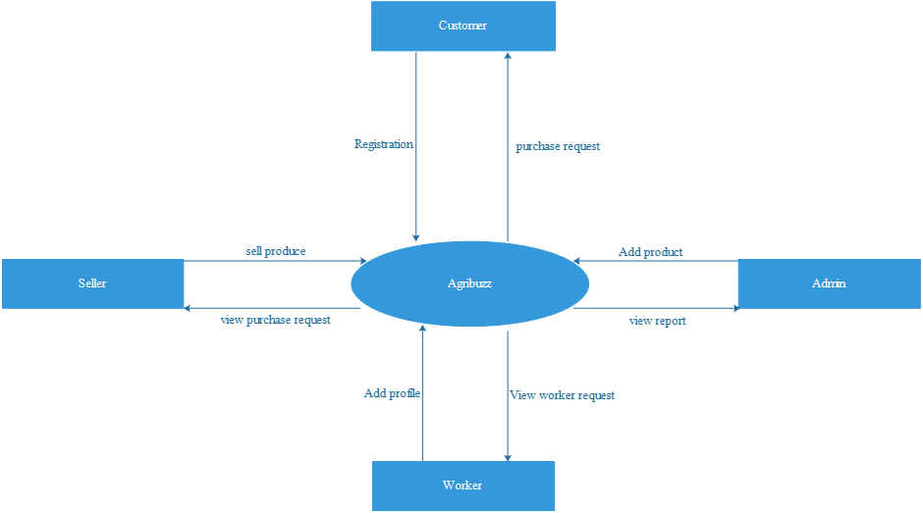
Context Flow Diagram
The Context Flow Diagram (CFD) describes the external entities acting on the system. The environment in which the system is used is depicted in the figure.
E-Farm

Slide 25
Data Flow Diagram
A Data Flow Diagram (DFD) is a graphical representation of the “flow” of data through an Information System.
A DFD also can be used for the visualization of Data Processing. It is common practice for a designer to draw a context-level DFD first which shows the interaction between the system and outside entities.
This context-level DFD is then “exploded” to show more detail of the system being modeled
The DFD uses four symbols, and are explained in next slides:

Slide 26


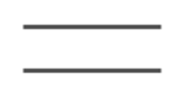
Symbol | Description
 | The circle or bubble represents a process. A process is named and each process is represented by a named circle.
 | The source or sink is represented as a rectangular box. The source or sink is the net originator or the consumer of the data that flows in the system.
 | The arrow represents the flow of data through the system. The labeled arrows enter or leave the bubbles.
 | The database is represented with the open box symbol.

Slide 27
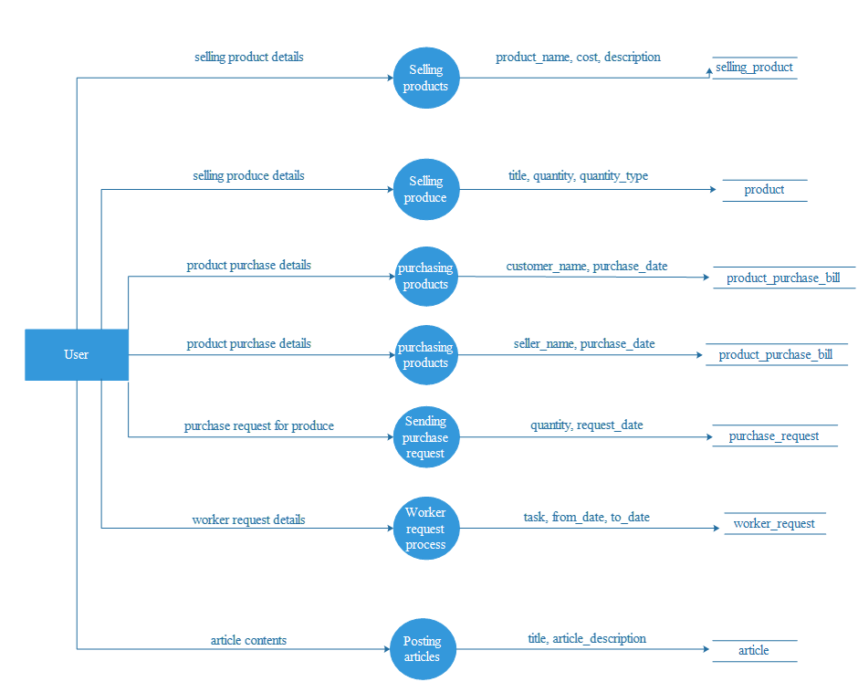
Top Level DFD – Level 1:

Slide 28
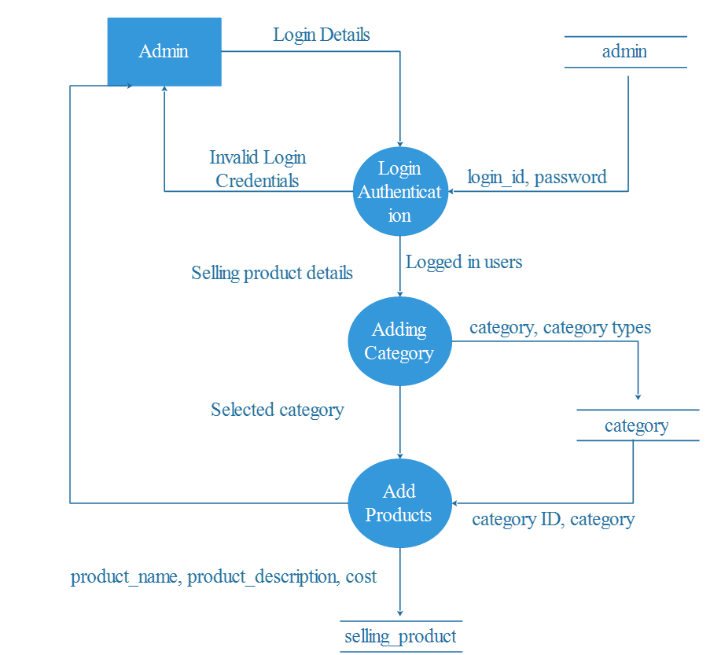
DFD Level 2:

Slide 29
DFD Level 3:

Slide 30
DFD Level 4:

Slide 31
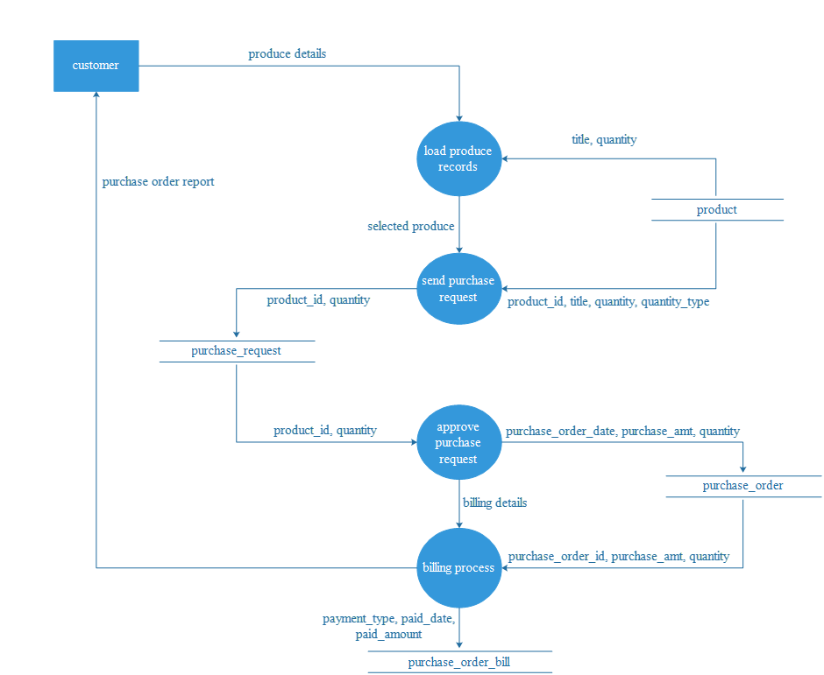
DFD Level 5:

Slide 32
DFD Level 6:

Slide 33
DFD Level 7:­­­

Slide 34
Database Design

Slide 35
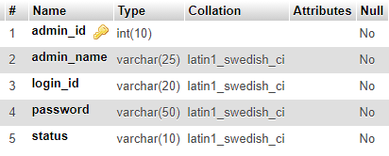
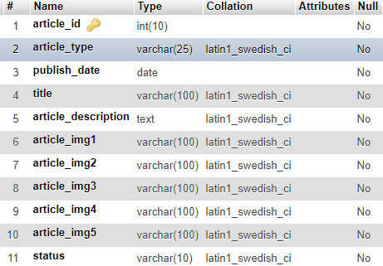
Admin table
Article table

Slide 36
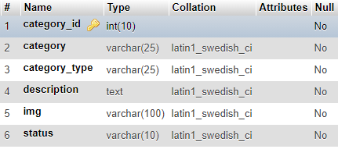
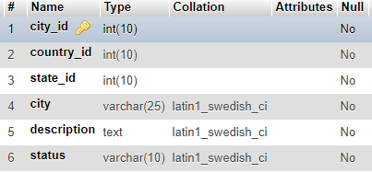
Category table
City table

Slide 37
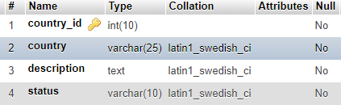
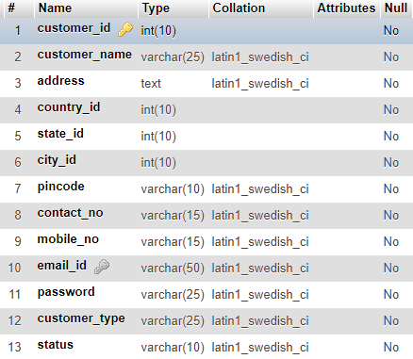
Country table
Customer table

Slide 38
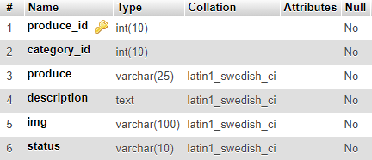
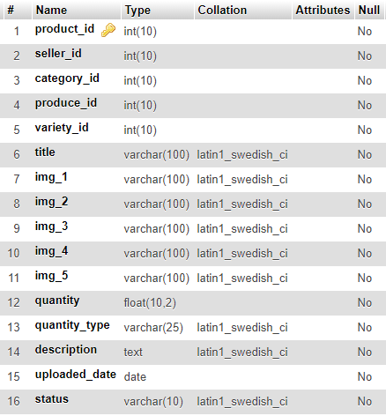
Produce table
Product table

Slide 39
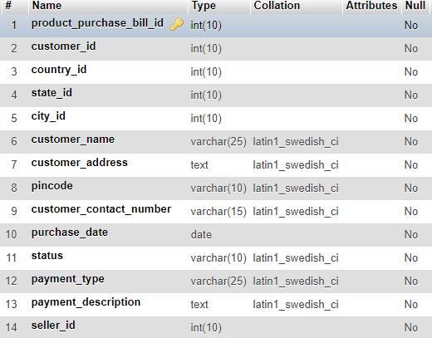
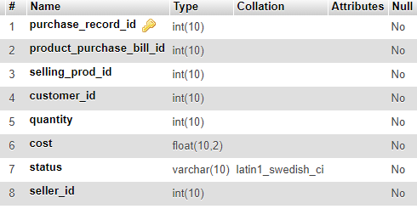
Product purchase bill table
Purchase order record table

Slide 40
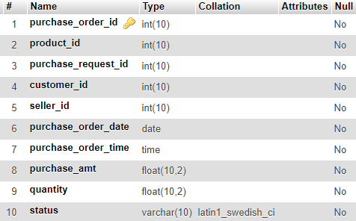
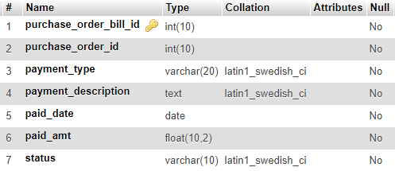
Purchase order table
Purchase order bill table

Slide 41
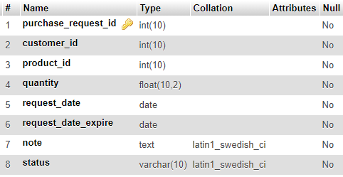
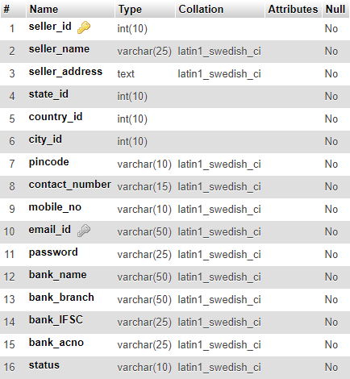
Purchase request table
Seller table

Slide 42
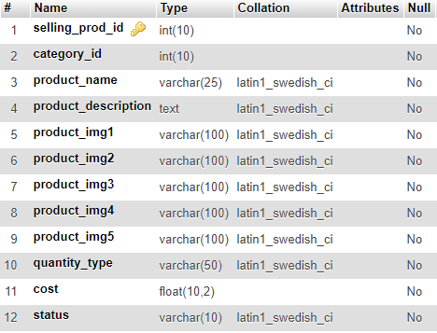
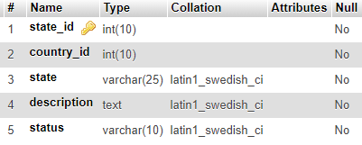
Selling product table
State table

Slide 43
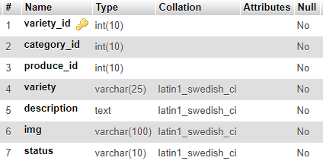
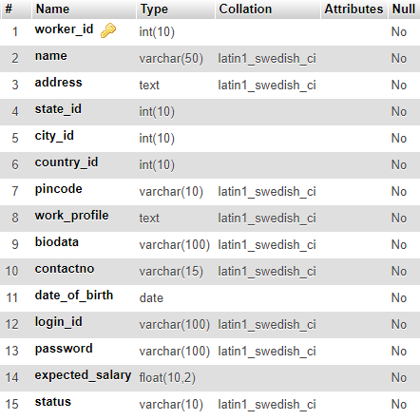
Variety table
Worker table

Slide 44
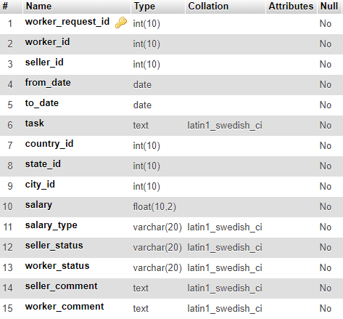
Worker request table

Slide 45
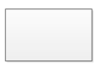


Entity-Relationship Diagram
Name | Notation | Description
Entity |  | Entity is represented by a box within the ERD. Entities are abstract concepts, each representing one or more instances of the concept in question. An entity might be considered a container that holds all of the instances of a particular thing in a system. Entities are equivalent to database tables in a relational database, with each row of the table representing an instance of that entity.
Relationship |  | Relationships are represented by Diamonds. A relationship is a named collection or association between entities or used to relate to two or more entities with some common attributes or meaningful interaction between the objects.
Attributes |  | Attributes are represented by Oval. An attribute is a single data item related to a database object. The database schema associates one or more attributes with each database entity.

Slide 46
ER Diagram

Slide 47
ER Diagram

Slide 48
Detailed Design

Slide 49
Modular Decomposition Of Components
Customer Component:
Structure chart for customer:

Slide 50
Admin Component:
Structure chart for admin:
Seller Component:
Structure chart for Seller:

Slide 51
Worker Component:
Structure chart for worker:
Settings Component:
Structure chart for Settings:

Slide 52
TESTING

Slide 53
Levels of Testing:
Unit Testing
Integration Testing
System Testing

Slide 54
Admin Component
Serial No. | Condition To be Tested | Test Data | Expected Output | Remarks
1. | If any field in the form is empty. | Value of form fields. | Alert the user to enter all the fields and then proceed. | SUCCESSFUL
2. | If admin name contains other than Character values. | adminname | Alert the user to enter only Characters and return to same page. | SUCCESSFUL
3. | If login ID is invalid. | loginid | Alert the user to enter a valid login ID and return to the same page. | SUCCESSFUL
4. | If password length is not between 8 to 16 characters. | password | Alert the user to enter a password of length between 8 to 16 characters. | SUCCESSFUL
5. | If confirm password and password does not match. | cpassword, password | Alert the user to enter matching password and confirm password. | SUCCESSFUL

Slide 55
Customer login:
Serial No. | Condition To be Tested | Test Data | Expected Output | Remarks
1. | If any field in the form is empty. | Value of form fields. | Alert the user to enter all the fields and then proceed. | SUCCESSFUL
2. | If the E-mail ID and Password does not match. | emailid, password | Alert user that E-mail ID and password are not matching and stay in the same page. | SUCCESSFUL

Slide 56
Worker Change Password
Serial No. | Condition To be Tested | Test Data | Expected Output | Remarks
1. | If field in the form is empty. | Value of form fields. | Alert the user to enter the fields and then proceed. | SUCCESSFUL
2. | If the E-mail ID is invalid. | loginid | Alert user to enter a valid E-mail ID and stay in the same page. | SUCCESSFUL
3. | If the old password is not between the given range of 8 to 16 characters. | oldpassword | Alert the user to enter a password of length between 8 to 16 characters. | SUCCESSFUL
4. | If the new password is not between the given range of 8 to 16 characters. | newpassword | Alert the user to enter a password of length between 8 to 16 characters. | SUCCESSFUL
5. | If the confirm password and password does not match. | cpassword, password | Alert user that confirm password and password are not matching and stay in the same page. | SUCCESSFUL

Slide 57
Variety Component
Serial No. | Condition To be Tested | Test Data | Expected Output | Remarks
1. | If field in the form is empty. | Value of form fields. | Alert the user to enter the fields and then proceed. | SUCCESSFUL
2. | If category is not selected. | category | Alert the user to select a category. | SUCCESSFUL
3. | If produce is not selected. | produce | Alert the user to select a produce. | SUCCESSFUL
4. | If variety contains values other than characters. | variety | Alert the user to enter only characters for variety. | SUCCESSFUL
5. | If image is not selected. | img | Alert the user to select an image. | SUCCESSFUL

Slide 58
Produce component
Serial No. | Condition To be Tested | Test Data | Expected Output | Remarks
1. | If any field in the form is empty. | Value of form fields. | Alert the user to enter all the fields and then proceed. | SUCCESSFUL
2. | If category is not selected. | category | Alert the user to select a category. | SUCCESSFUL
3. | If produce is not selected. | produce | Alert the user to select a produce. | SUCCESSFUL
4. | If image is not selected. | img | Alert the user to select an image. | SUCCESSFUL

Slide 59
Conclusion

Slide 60
The project “AgriBuzz” is a man-made project and, therefore, there may be mistakes and limitations.
The ideas put up may be different.
The terms and names may be different.
However, our sincere effort was to give the best.
The advanced techniques like sensor technology can be used in the future for measuring the quality of the product.

Slide 61
Limitations

Slide 62
The project is web application and internet connection is required to access the website.
The administrator and seller should keep status online to check latest transactions.
The workers must be active on the website to view their work requests.

Slide 63
Future Scope

Slide 64
We can create Android or iOS application for this project.
We can make use of sensor technology to measure the quality of the product.
We can include SMS alert in which the Customer will get alert SMS’s when new item is purchased, New product released, Delivery date, etc.

Slide 65
Bibliography

Slide 66
www.google.com
www.wikipedia.com
www.w3school.com
www.stackoverflow.com
www.highcharts.com

Slide 67
Thank You

